Slide 1
Twitch Data science Project
Name: Yuval Alter
Id: 325772937

Slide 2


Background
Twitch.tv is a website that is owned by amazon and is used for live streaming. It was created in 2011 and is now the most popular live streaming website with more than 15 million daily users and 2 million monthly live streams.

Slide 3
Why is this useful?
On Twitch streamers can take sponsorships from external companies, the companies pay money for exposure on a streamer stream. This project idea is to help the companies decide if they should sponsor a streamer or not by trying to predict the streamers average views for the next 30 days, the more viewers a streamer gets the more exposure the company gets.

Slide 4
Project Roadmap
1
2
3
4
5
Getting the dataset by web crawling a website
Formatting the data and removing broken lines and outliers
Visualize the data
Train the linear regression model
Final model

Slide 5
Getting The Data

Slide 6
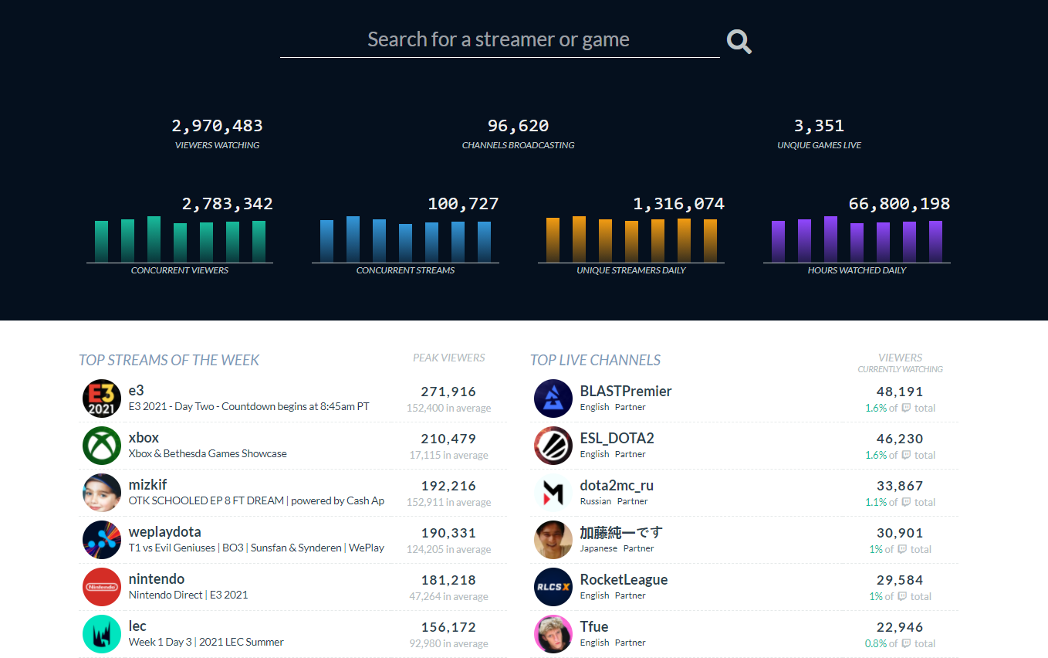
Getting the data
To get the data I’m going to use the website Twitchtracker.com that provides data on tens of thousands of streamers. To do that I’ll use a crawling algorithm I wrote to parse trough 10,000 samples of data and extract them into a csv file

Slide 7
Getting the data
Problems
While trying to get the data I ran into a problem, the website I was using was loading it’s tables after the pages were loaded so beautifulSoup couldn't find the lines I was looking for. To solve this problem I hade to move to using Selenium for web scraping because it use’s the computer browser (in my case Google chrome) to scrape the website, the only downside of this solution was that it was really slow and I had to go over at least 200 pages of data so it took multiple hours

Slide 8
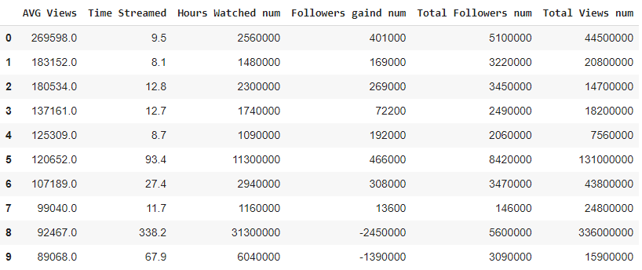
Getting the data
The Dataframe

Slide 9
Cleaning The Data

Slide 10
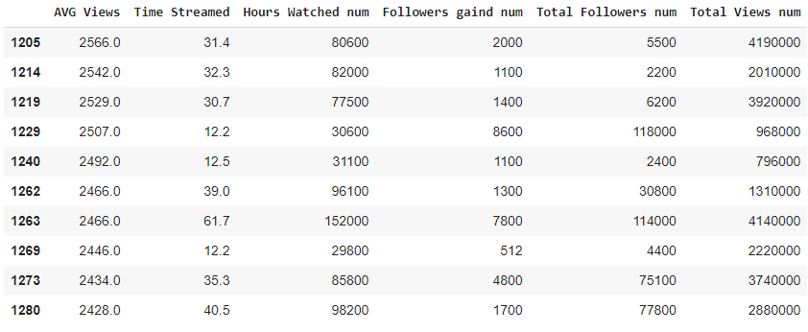
Cleaning the data
Dealing with missing values:
Removing any rows with one or more missing values
Dealing with corrupted rows:
Some of the rows in the Database had corrupted values with non-English letters instead of numbers, these rows had to be removed manually
Formatting
The data that was scraped from the website was formatted as strings instead of numbers (1m instead of 1,000,000) so these values were converted to numbers

Slide 11
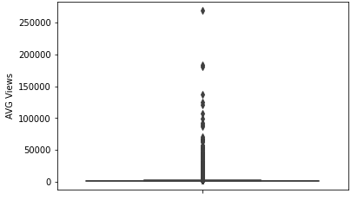
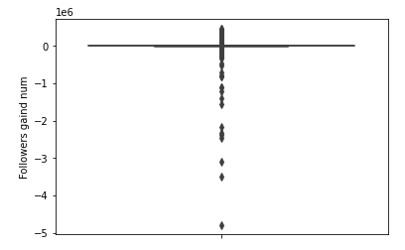
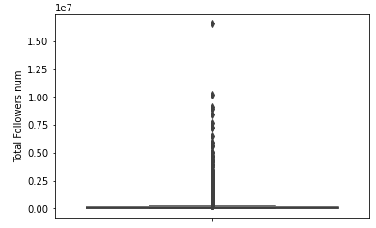
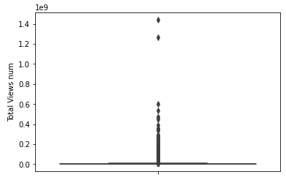
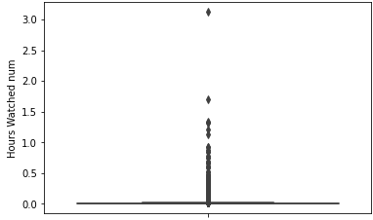
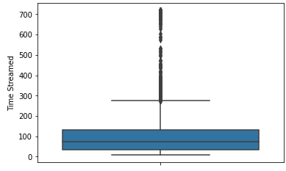
Cleaning the data
Dealing with outliers:
Because of the database size (10,000) the data had a lot of outliers. I used the 1.5IQR test to find and remove all of the outliers

Slide 12
Visualizing The Data

Slide 13
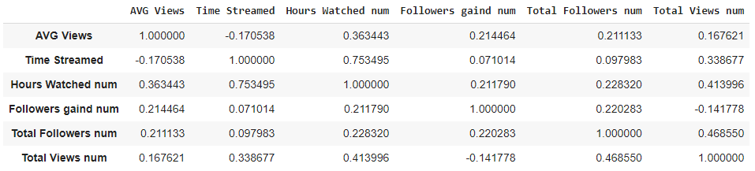
Visualizing the data
Correlation table

Slide 14
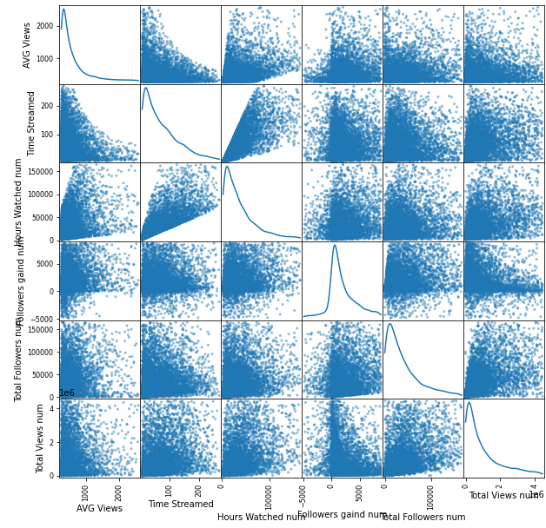
Visualizing the data
Correlation matrix

Slide 15
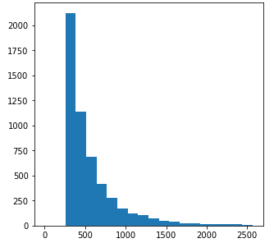
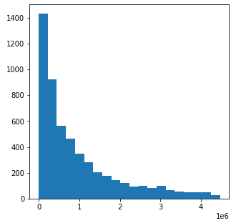
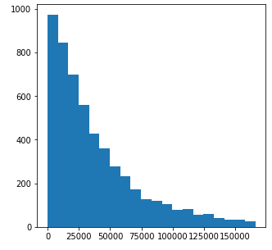
A histogram of the Total views feature. It shows that a total low viewership count is the most common in my data, this matches the AVG views histogram
A histogram of the AVG Views feature. It shows that high viewership count is the least common in my data
A histogram of the total followers feature. It shows that most of the channels in my data are not very popular

Slide 16
The ML Model

Slide 17

The ML model
Linear Regression
Using the sklearn library I used the linear regression model to train a model that can predict the average number of views of a twitch channel for the next 30 days using 5 features: Time streamed, Hours watched, Followers gained, Total followers, Total Views.

Slide 18
The ML model
Linear Regression result
B1=-6.71205982e+00
B2=1.25755922e-02
B3=9.62878909e-03
B4=2.13389259e-04
B5=2.16950329e-05
Intercept = 533.01
R2 = 0.595
The model can explain 59.5% of the results

Slide 19
The ML model
Trying to upgrade the model
If we look at the correlation table again we can see that there is a 75% correlation between the Hours watched and Time streamed and 46% correlation between the Total views and the total followers so I added their multiplication to the ML model.

Slide 20
The ML model
2nd Linear Regression result
B1=-5.32824640e+00
B2=1.56400383e-02
B3=8.03960164e-03
B4=-1.17756257e-03
B5=1.68958345e-05
B6=-3.03237239e-05
B7=1.03537036e-08
Intercept = 474.733
R2 = 0.62
The model can explain 62% of the results

Slide 21
Conclusions
- There is a high correlation between the hours watched and the AVG views which means that there are a lot of people that watch a part of a stream and not a few people that watch the entire stream.
- There is a correlation of about 50% between the total views and total followers, that means that about 50% of a streamer views are his followers.

